Slide 1
Mobile Application Development - Day 2
Git
View and ViewGroup
Splash Screen
Intent
Log
Toast
Snackbar

Slide 2
View
View objects are the basic building blocks of User Interface(UI) elements in Android.
Eg
TextView, RadioButton, ListView,Spinner and many more
responds to the user's actions.
Eg
EditText, Button, CheckBox etc
View refers to the android.view.View class, which is the base class of all UI classes.

Slide 3
ViewGroup
Subclass of View
ViewGroup is the invisible container. It holds View
Eg
LinearLayout is the ViewGroup that contains Button(View), and other Layouts also.
ViewGroup is the base class for Layouts.

Slide 4
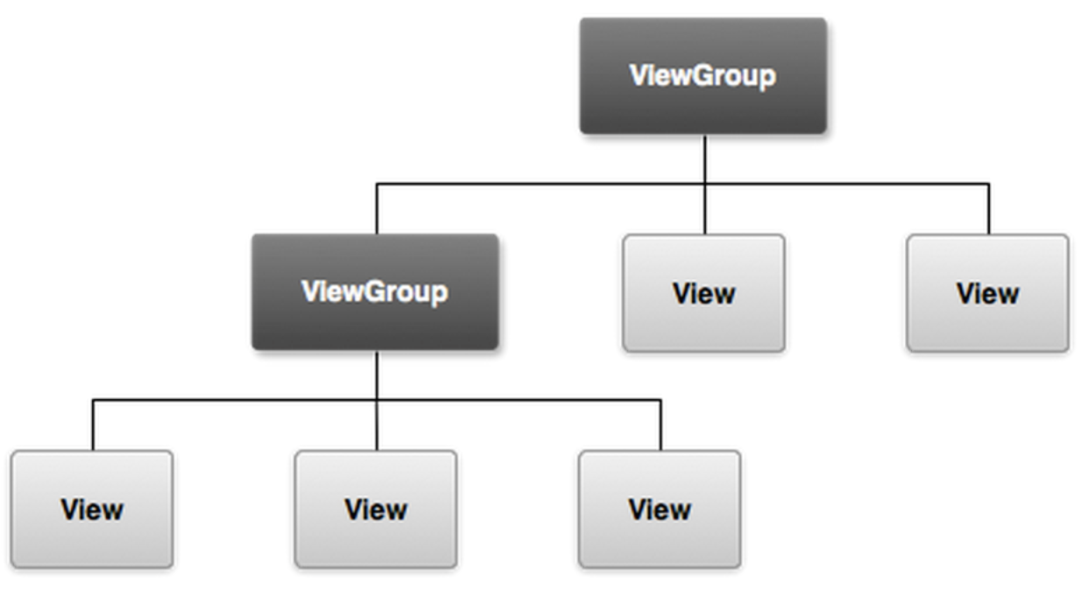

Slide 5
Git
GitHub
github.com
Bitbucket
bitbucket.org
Gitlab
gitlab.com

Slide 6
Git Commands
git pull
git push
git branch
git log
git diff
git stash
……………… many more

Slide 7
Intent
An intent is an abstract description of an operation to be performed
It can be used to :
Start Activity
Communicate with background service
Broadcast Receiver

Slide 8
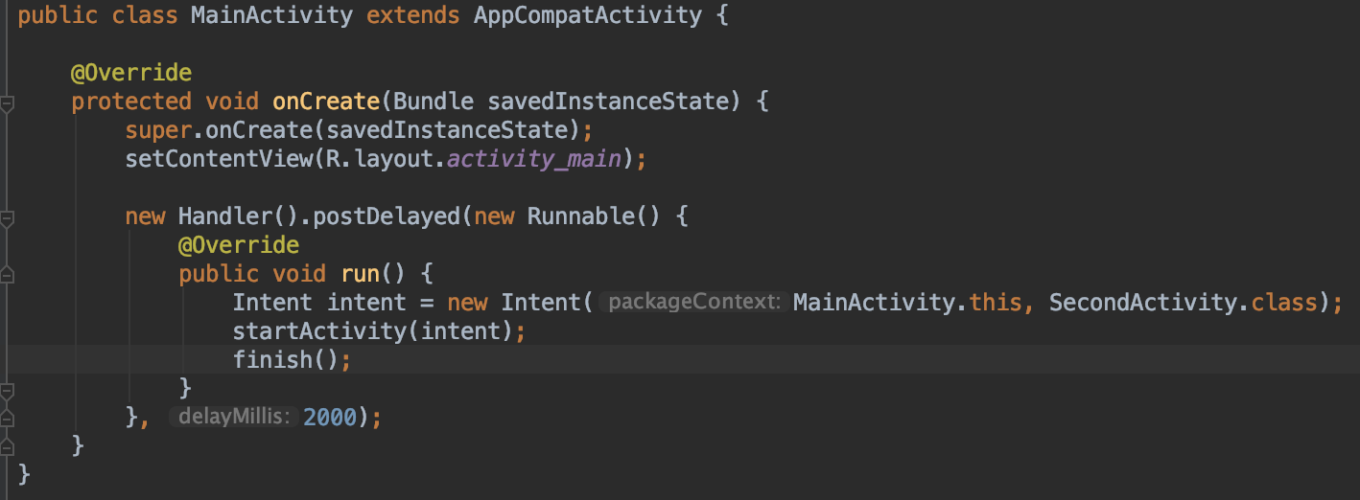
Intent

Slide 9
Intent Types
Implicit Intent
Eg.
File sharing
you don't know which activity of which application/s can handle your request.
Explicit Intent
Eg.
Starting activity using startActivity(....);
Notes:
Implicit Intents are used when you have an idea of what you want to do, but you do not know which component should be launched. Or if you want to give the user an option to choose between a list of components to use.
Explicit Intents are used to call a specific component. When you know which component you want to launch and you do not want to give the user free control over which component to use.For example, you have an application that has 2 activities. Activity A and activity B. You want to launch activity B from activity A. In this case you define an explicit intent targeting activityB and then use it to directly call it.

Slide 10
Log
Android SDK includes a useful logging utility class called android.util.Log
Logging messages are categorized by severity
Error
Warnings
Informational
Debug
Verbose
Log.v(TAG, "index=" + i);

Slide 11
Log methods
The Log.e() method is used to log errors.
The Log.w() method is used to log warnings.
The Log.i() method is used to log informational messages.
The Log.d() method is used to log debug messages.
The Log.v() method is used to log verbose messages.
The Log.wtf() method is used to log terrible failures that should never happen. ("WTF" stands for "What a Terrible Failure!" of course.)

Slide 12
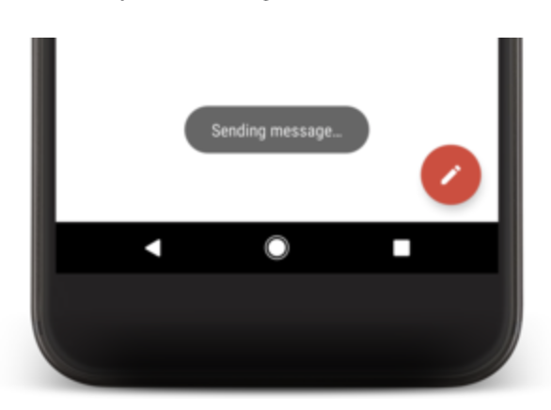
Toast
A toast provides simple feedback about an operation in a small popup
Toasts automatically disappear after a timeout
Toasts are not clickable
Toast.makeText(context, text, duration).show();
int duration = Toast.LENGTH_SHORT;
int duration = Toast.LENGTH_LONG;

Slide 13
Question Samples
What is View and ViewGroup? [5]
What do you understand by intent? Explain its type. Write a sample program of intent for passing data ?[2+3+5=10]
Short notes[2x4=8]
Log
Snackbar
Toast
Git

